Slide 1

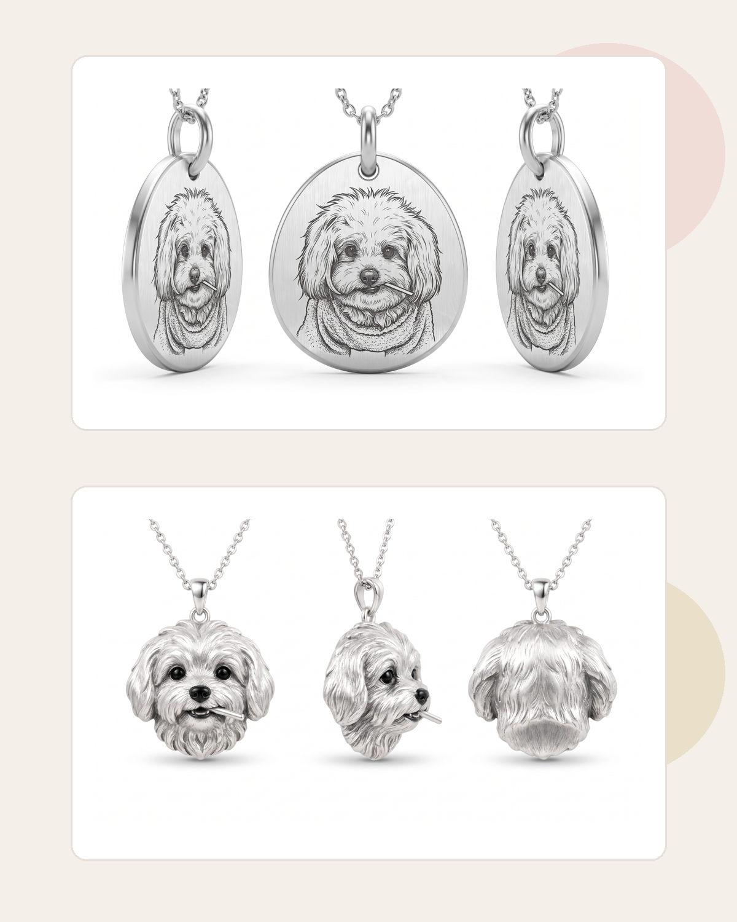
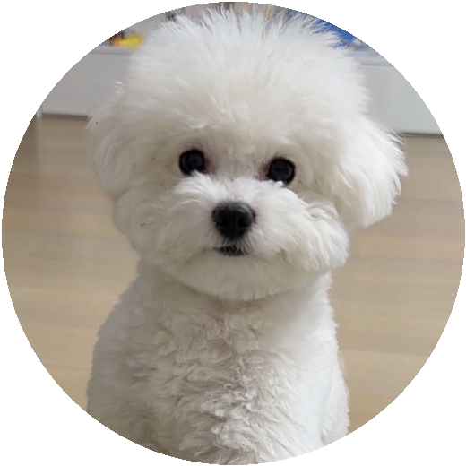
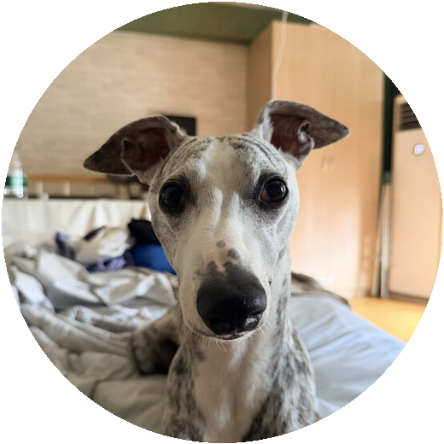
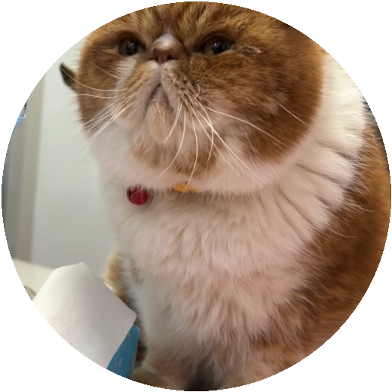
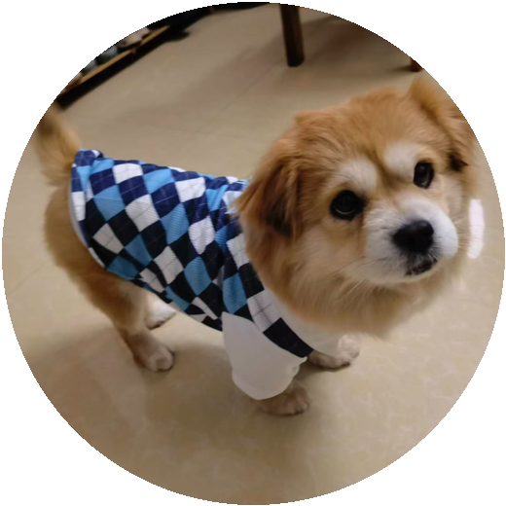
JEWELRY FOR YOUR
FUR FAMILY
Custom pet portrait jewelry inspired by the photos, expressions and stories you treasure.
Personal. Playful. Made to be remembered.
Designed for every beloved companion
LOLLIPOP KEEPSAKE DUO
WhatsApp +86 18959291857
marketing@ornovai.com

Slide 2
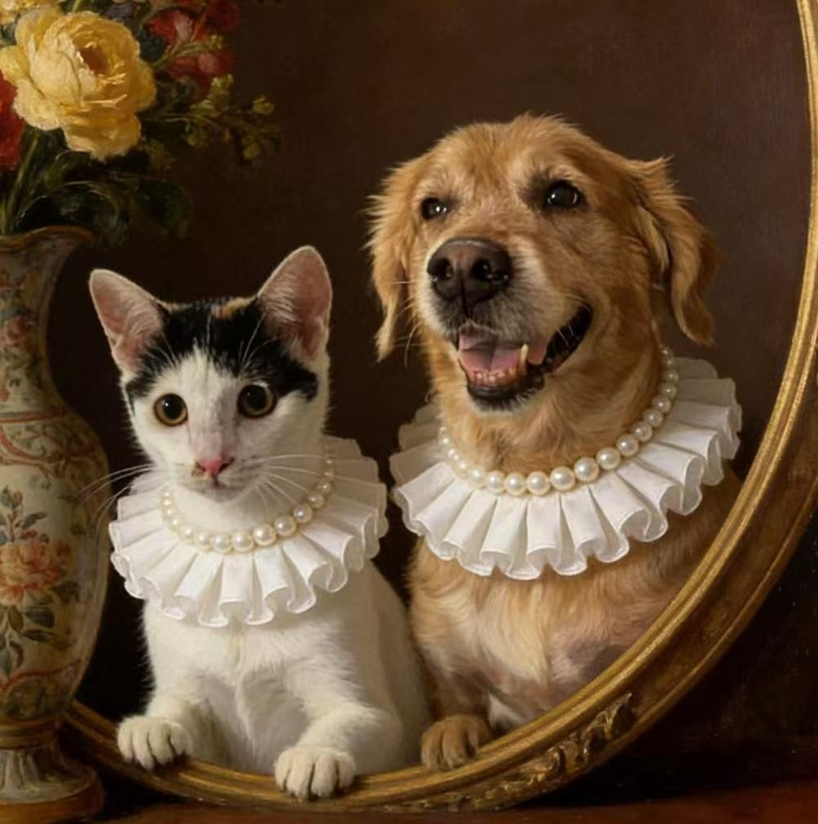
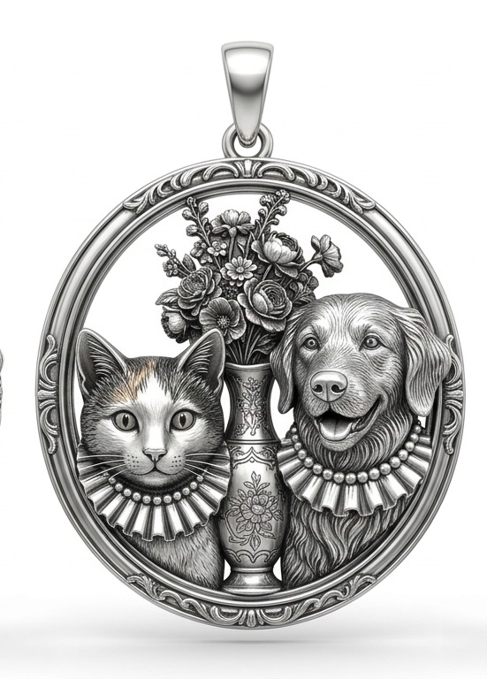
OUR PURPOSE
More Than a Pet. More Than Jewelry.
We turn real pet photos into warm, wearable keepsakes—designed around the individual animal, not a generic template.
We specialize in custom jewelry for dogs, cats and every companion who feels like family. Each piece begins with the details owners know by heart: the eyes, the coat, the posture, the favorite outfit—and the personality behind them.
01
Photo-led likeness
We study the individual face, coat pattern, posture and expression—not only the breed.
→
02
Emotion-led design
Favorite outfits, smiles, flowers and symbols can become part of the story.
03
Jewelry-ready artistry
Every concept is balanced for a clear silhouette, readable detail and wearable scale.
THE JEWELRY STORY
THE ORIGINAL PORTRAIT
“A little portrait you can keep close, every day.”
CUSTOM PET KEEPSAKE JEWELRY
02

Slide 3
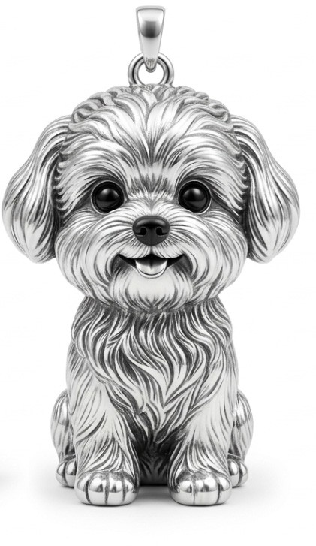
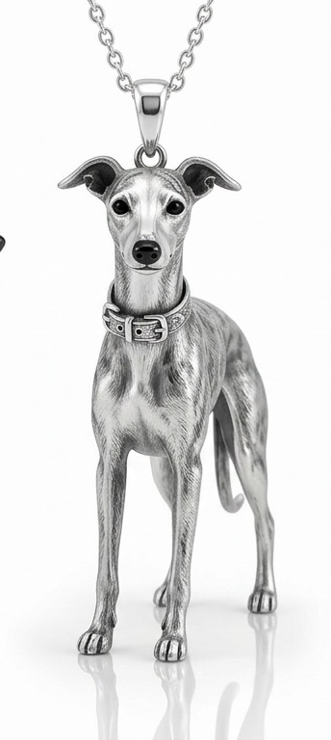
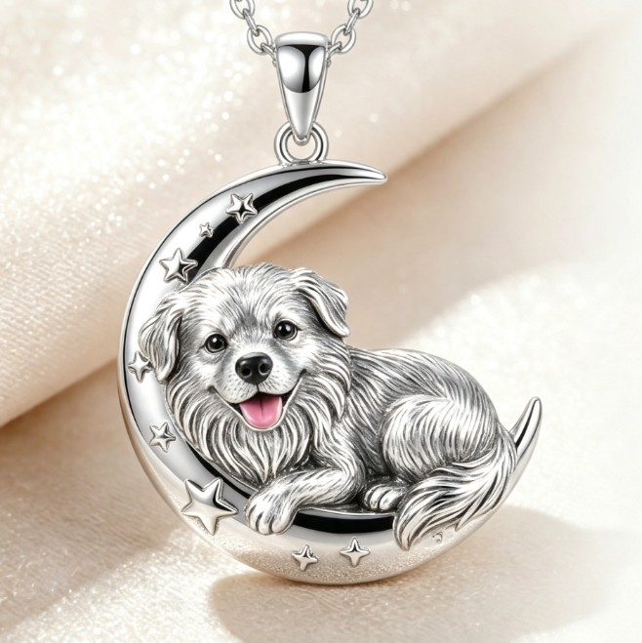
WHAT WE CREATE
A Collection as Individual as They Are
From simple portrait charms to story-rich medallions, every format can be tailored to the pet and the moment.
Portrait Charms
Full-Body Pendants
A compact character portrait focused on the face, coat volume and expression.
Posture, coat markings and signature accessories developed from multiple views.
Example: Cloud Pup Portrait Charm
Example: Silver Sprint Whippet Pendant
Story Pendants
Multi-Pet Medallions
Meaningful motifs—moons, florals, outfits or celebration details—built around the pet.
Two or more companions arranged as one collectible, heirloom-style family portrait.
Example: Moonlit Memory Pendant
Example: Royal Companions Portrait Medallion
CUSTOM PET KEEPSAKE JEWELRY
03

Slide 4
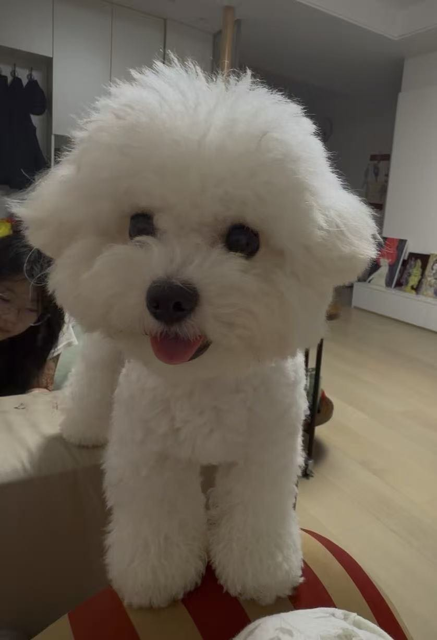
OUR PROCESS
From Favorite Photo to Wearable Keepsake
A clear, collaborative path helps preserve both likeness and emotion.
1
2
3
4
5
Share Photos
Character Study
Creative Direction
3D Visualization
Refine & Produce
Send 2–5 clear references.
Face, fur, markings and posture.
Realistic, cute, classic or modern.
Review form, detail and composition.
Confirm the final jewelry-ready design.
A better reference set creates a more confident design.
THE DESIGN BRIEF
Tell us the story behind the pet: a favorite outfit, a meaningful flower, a special pose or the feeling you want the piece to carry.
Front view + side view + favorite expression
PHOTO
RENDERING
CUSTOM PET KEEPSAKE JEWELRY
04

Slide 5
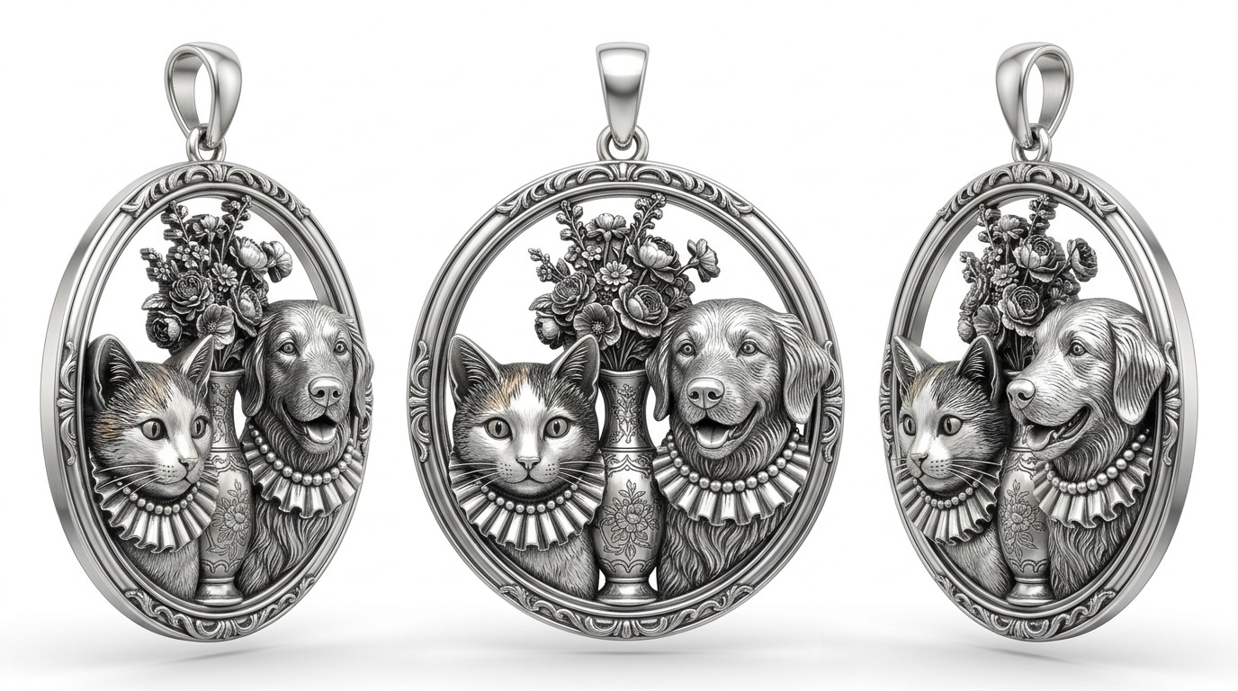
CASE 01
Royal Companions Portrait Medallion
A cat and golden retriever are composed into one elegant, heirloom-style family portrait.
→
SOURCE PORTRAIT
The original photograph already feels like a formal family portrait. The design preserves that mood through an oval frame, floral vase, pearl collars and balanced two-pet composition.
Two-pet composition
Classical oval frame
Floral storytelling
Pearl-collar detail
Heirloom mood
CUSTOM PET KEEPSAKE JEWELRY
05

Slide 6
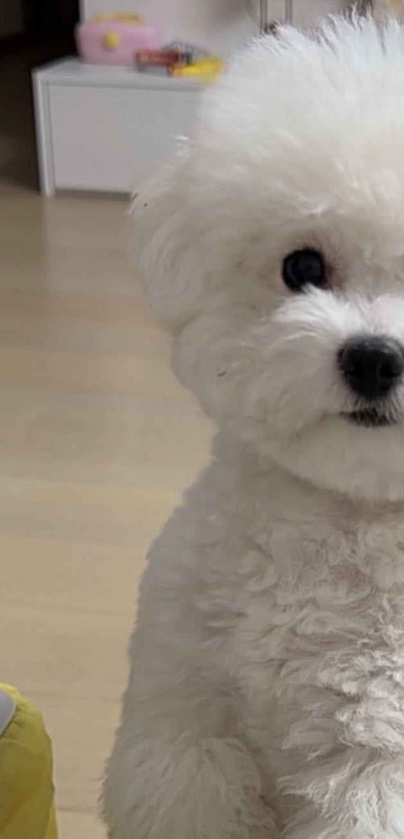
CASE 02
Cloud Pup Portrait Charm
Soft curls, round eyes and a cheerful little tongue become a compact sculptural character.
Signature details captured
Cloud-like coat volume
Round, dark button eyes
Friendly, youthful expression
Compact readable silhouette
Why multiple photos matter
One image shows the lively expression; the second clarifies the head shape and coat structure. Together, they support a more faithful likeness.
FRONT REFERENCE
SHAPE REFERENCE
PORTRAIT CHARM
CUSTOM PET KEEPSAKE JEWELRY
06

Slide 7
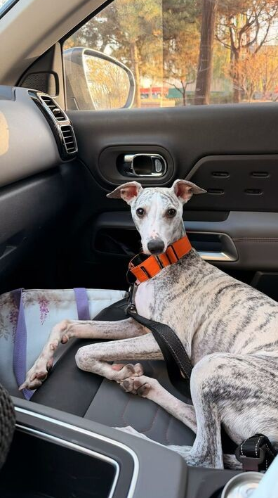
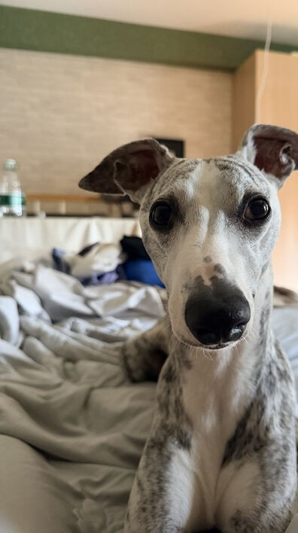
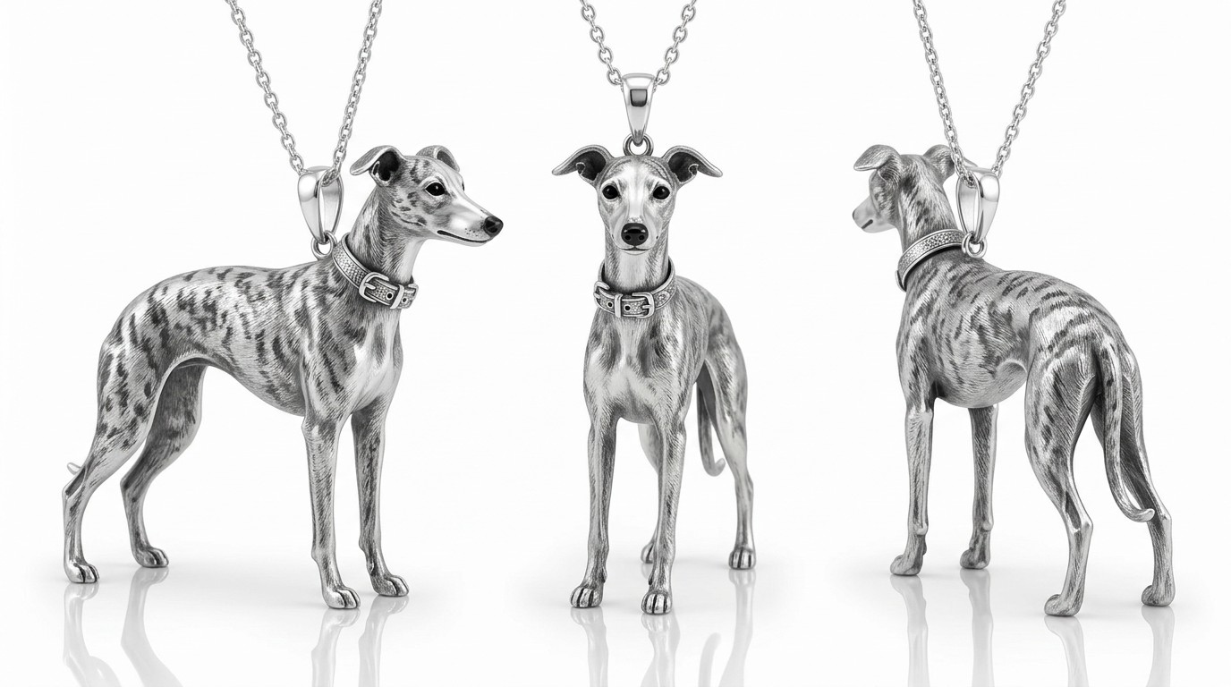
CASE 03
Silver Sprint Whippet Pendant
A three-view design preserves graceful anatomy, brindle markings and the signature orange collar.
BODY + MARKINGS
FACE + PROFILE
Three-view continuity
Elegant breed anatomy
Brindle marking map
Collar + buckle detail
360° character design
Front, profile and rear views are developed as one coherent character—not three disconnected illustrations.
CUSTOM PET KEEPSAKE JEWELRY
07

Slide 8
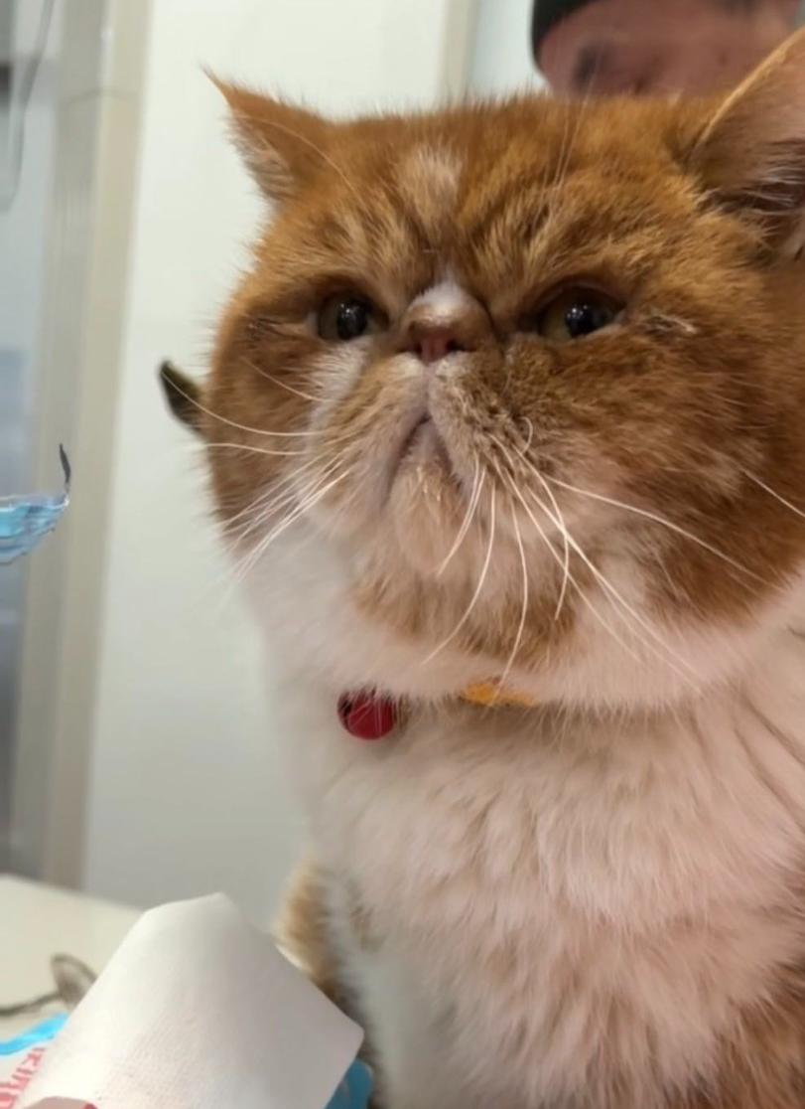
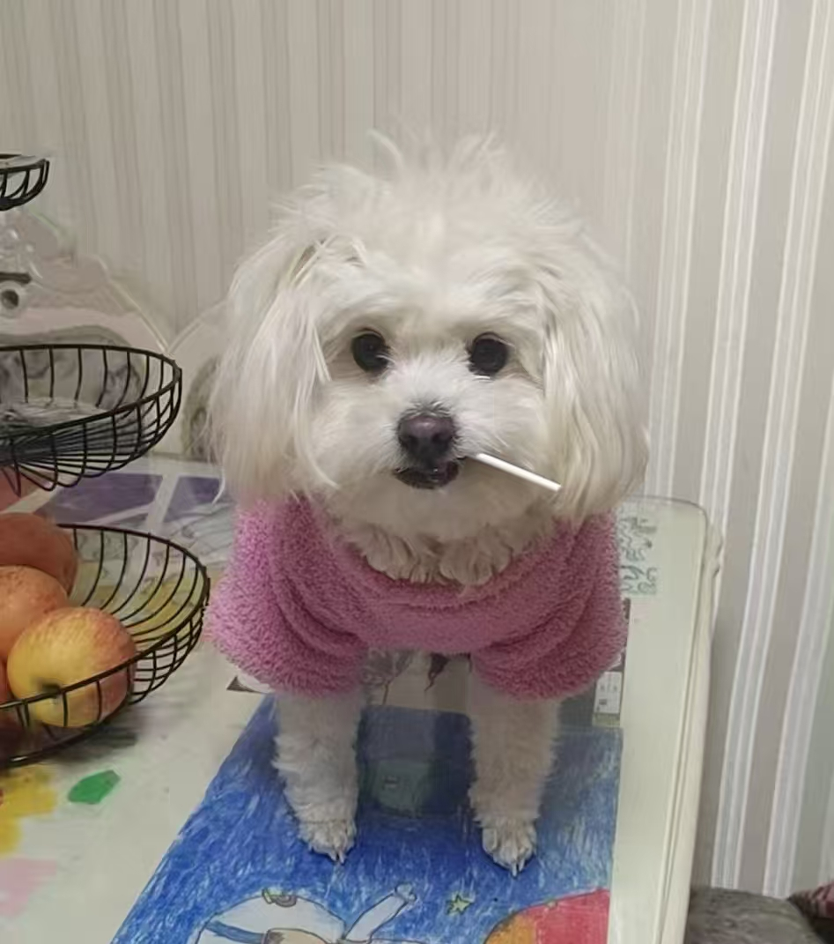
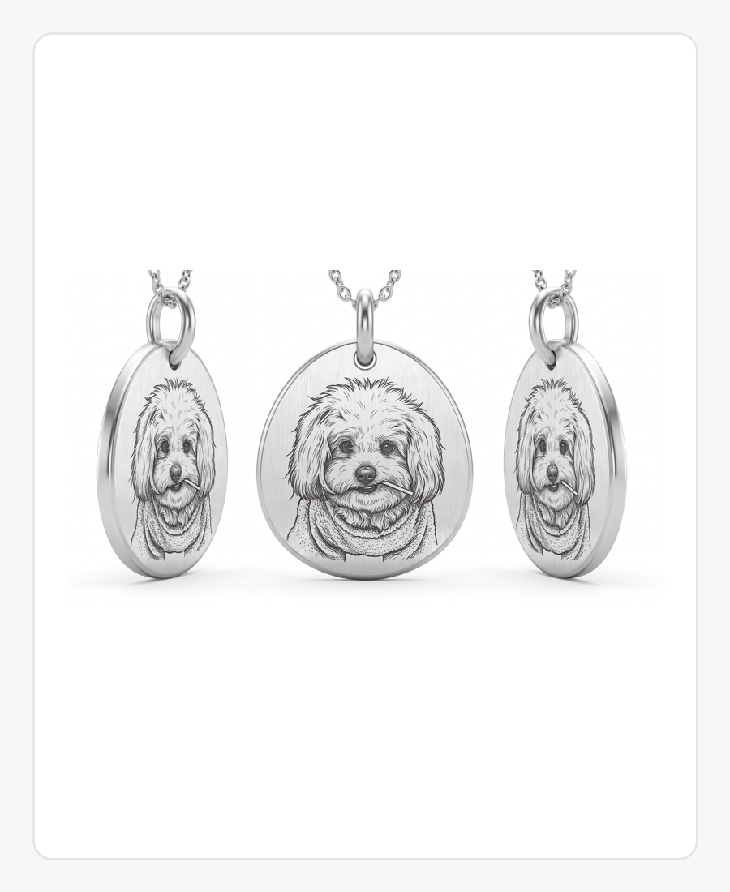
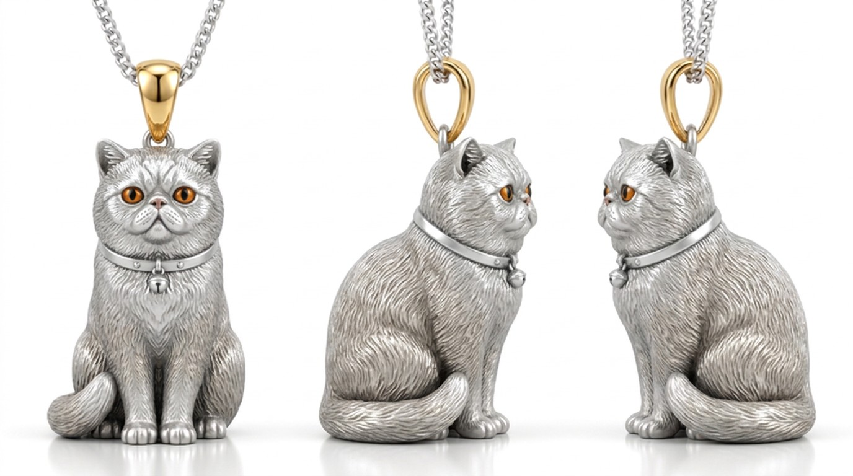
DISTINCT PERSONALITIES
Two Pets. Two Completely Different Design Languages.
The jewelry should feel unmistakably like the animal—from proud and regal to bright and celebratory.
REGAL GINGER CAT CHARM
LOLLIPOP PORTRAIT MEDALLION
SOURCE
JEWELRY RENDER
SOURCE
JEWELRY RENDER
Bold, round and unmistakably dignified.
Playful, gentle and instantly personal.
Copper-and-white coat • signature face • amber eye accent • bell collar
Lollipop detail • soft floppy ears • oval keepsake format • fine engraved linework
CUSTOM PET KEEPSAKE JEWELRY
08

Slide 9
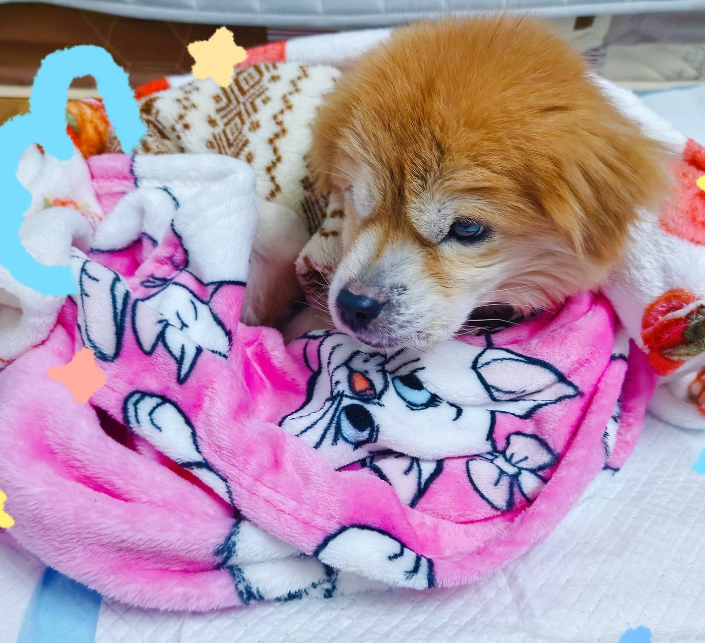
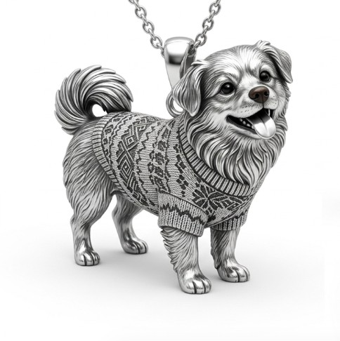
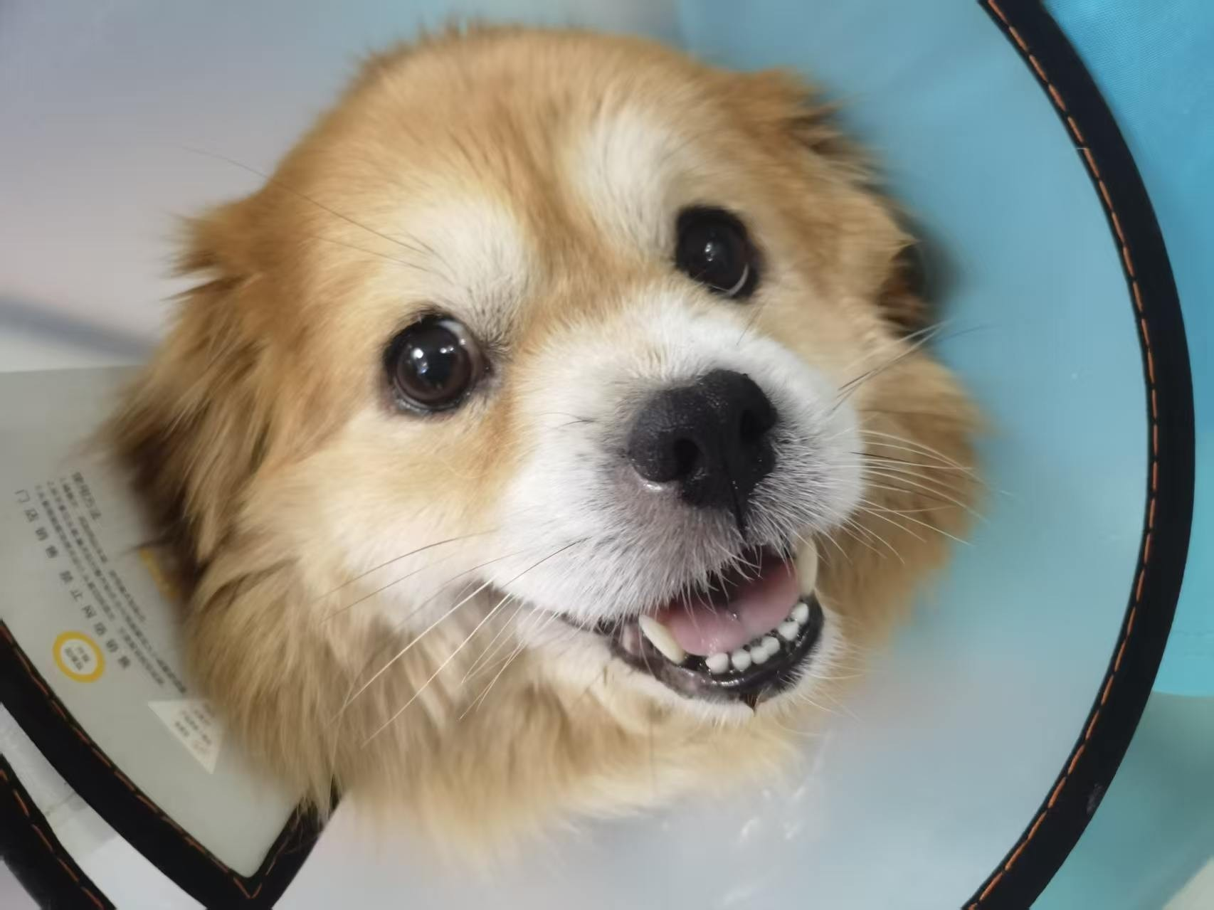
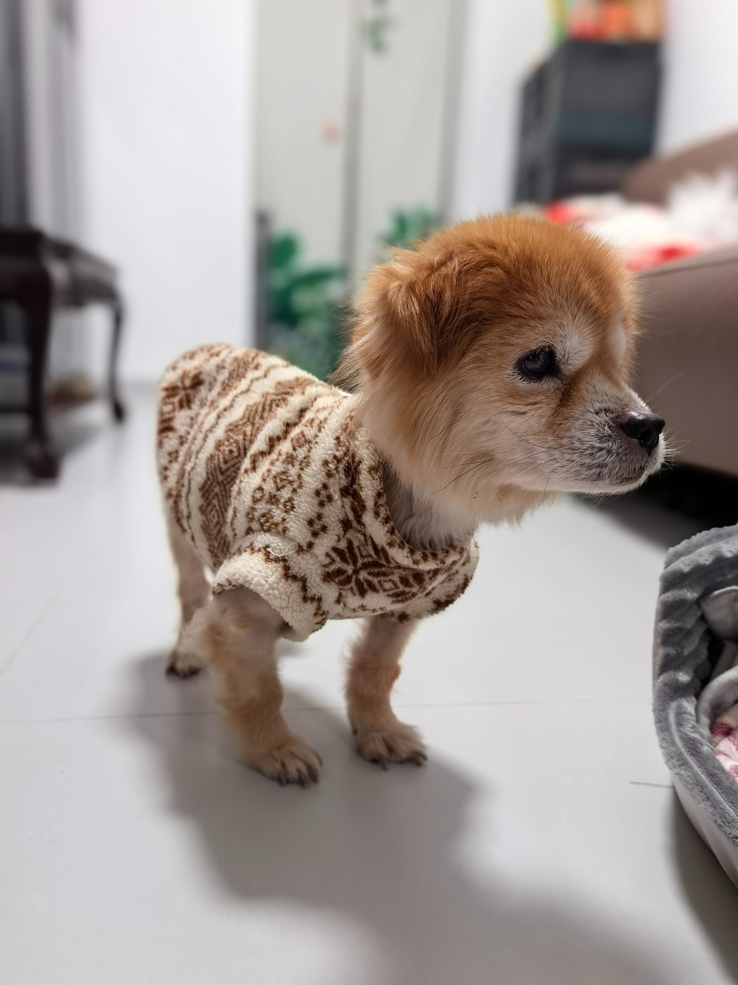
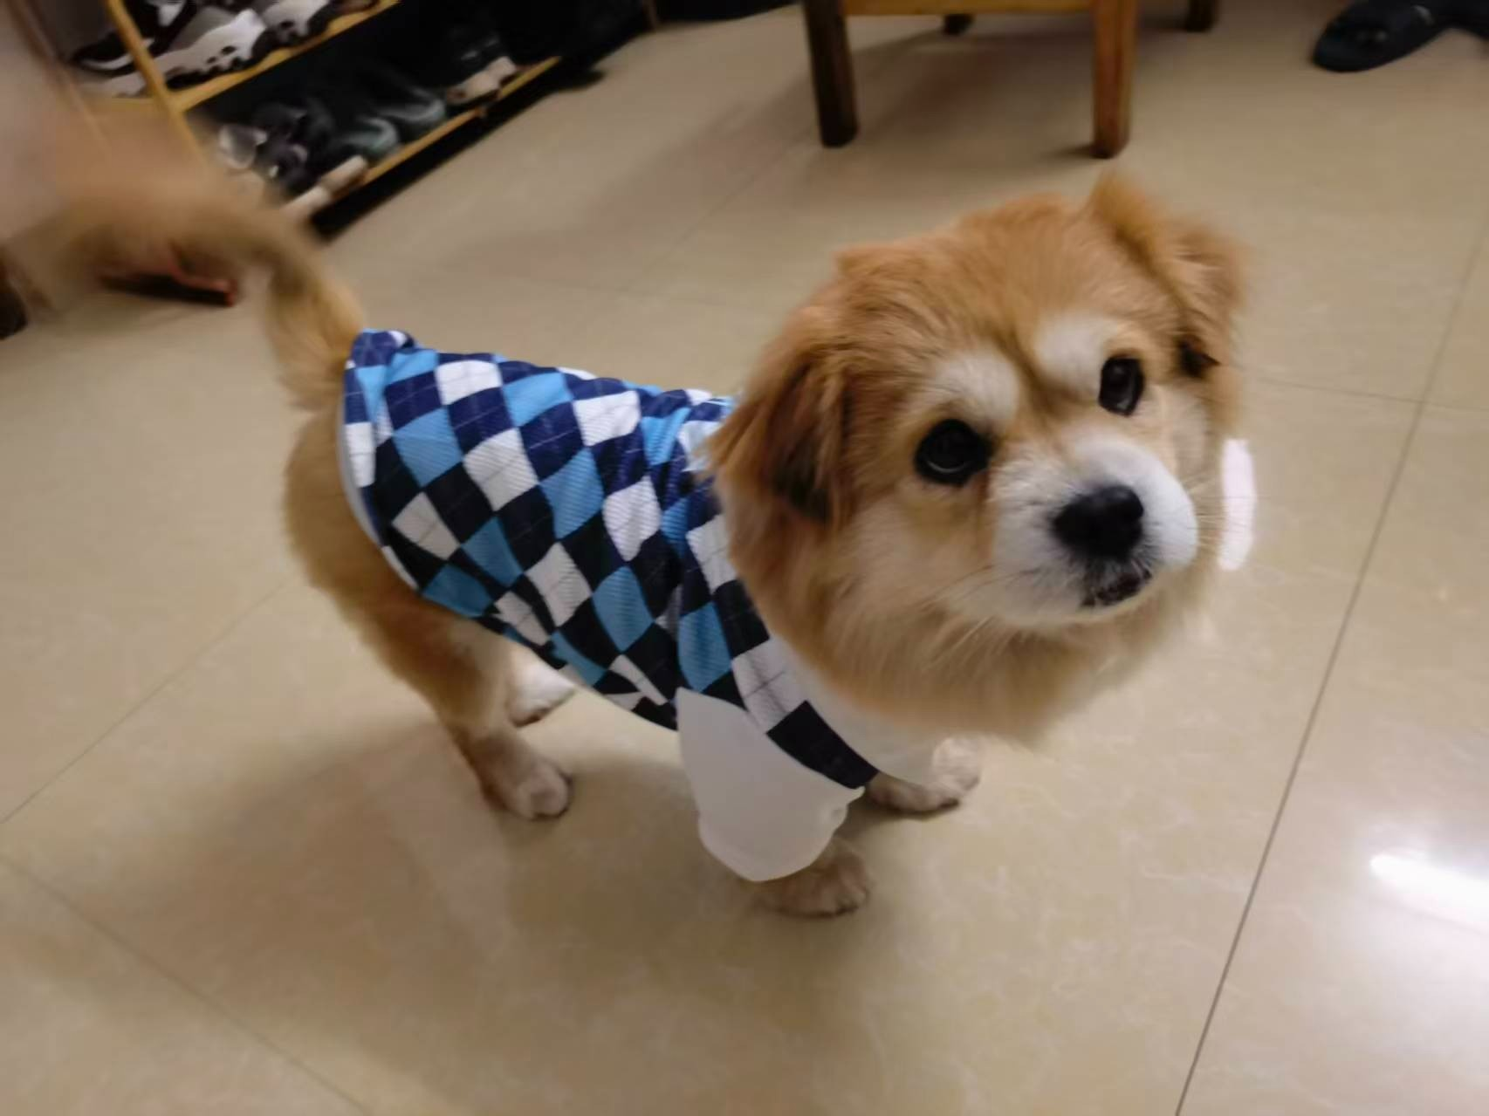
STORY COLLECTION
One Pet. Two Stories.
A favorite companion can inspire an entire collection—not just one charm.
COZY KNIT PORTRAIT PENDANT
MOONLIT MEMORY PENDANT
THE LITTLE GUARDIAN
Everyday warmth
Poetic remembrance
The favorite sweater pattern becomes part of the character, preserving an affectionate everyday memory.
The same companion rests inside a crescent moon, creating a softer and more symbolic keepsake.
CUSTOM PET KEEPSAKE JEWELRY
09

Slide 10
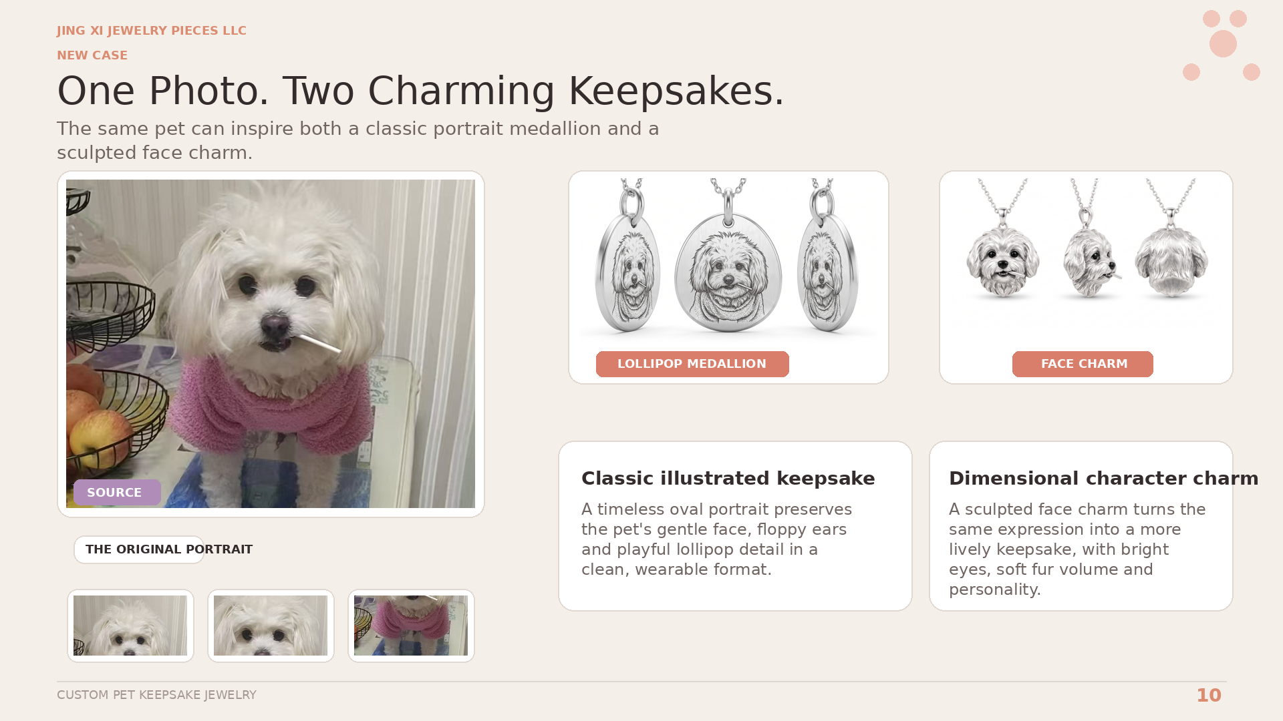

Slide 11
OUR ADVANTAGES
Why Our Work Stands Out
Emotional sensitivity and professional jewelry design discipline belong in the same process.
01
Pet-specific likeness
02
Multi-photo character study
03
Story-led customization
Built from the individual pet—never a generic breed template.
Front, profile and lifestyle photos improve proportion and markings.
Pose, outfit, collar and symbols can carry the owner’s story.
04
Professional 3D visualization
05
Flexible aesthetic direction
06
Collaboration-ready service
A clear rendering supports review before production.
Realistic, cute, classic, modern—or a blend for the project.
For custom commissions, gifting programs and brand projects.
WE COMBINE EMOTIONAL UNDERSTANDING WITH JEWELRY DESIGN DISCIPLINE.
CUSTOM PET KEEPSAKE JEWELRY
11

Slide 12
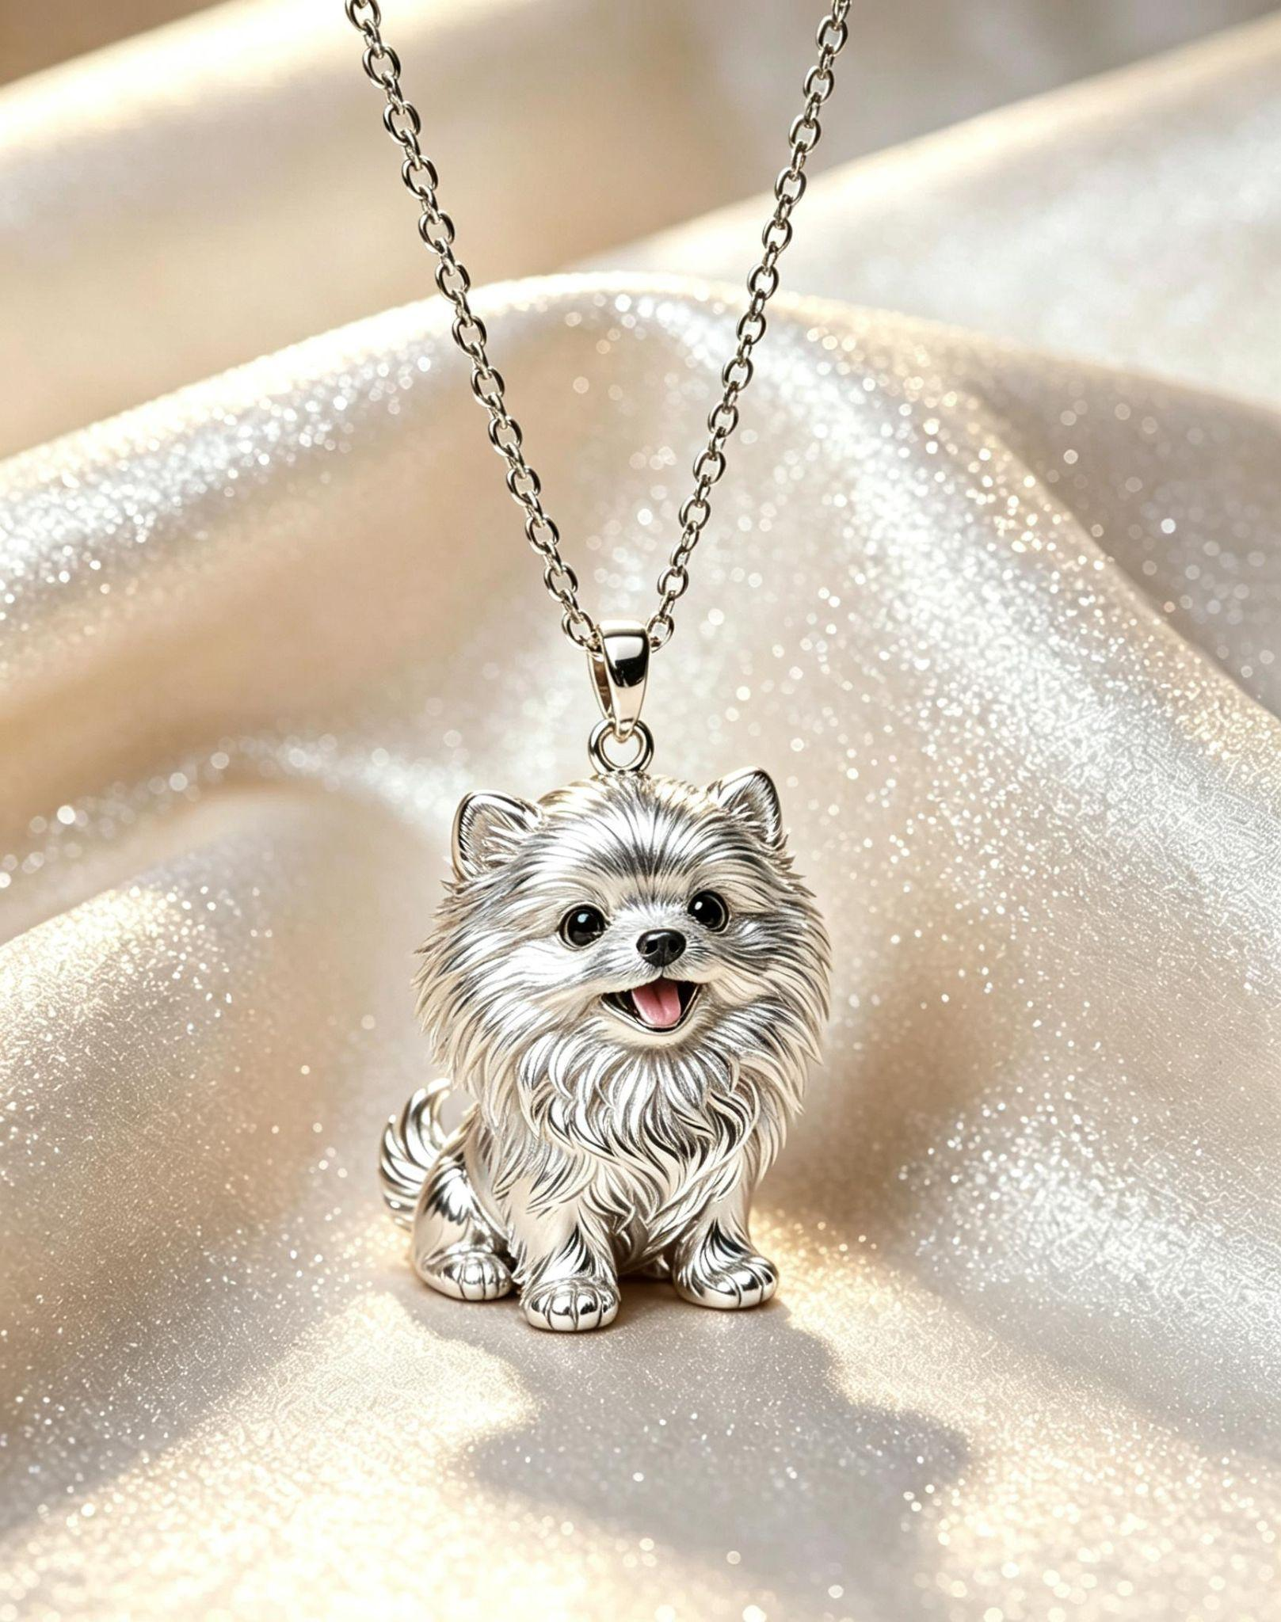

LET’S CREATE SOMETHING
UNFORGETTABLE
Send us 2–5 clear photos and tell us what makes your pet special. We will help shape the memory into a jewelry concept with warmth, character and professional detail.
START YOUR PROJECT
WhatsApp
+86 18959291857
Email
marketing@ornovai.com
ORNOVAI
Scan to chat
Thank you

